Slide 1




Intelligent Innovators
Home
Service
About Us
Contact
COMM AI

Slide 2

Intelligent Innovators
Home
Service
About Us
Contact
ABOUT US
Comm AI is a cutting-edge project designed to analyze and enhance human communication skills by using an AI-driven system. The tool interacts with users through text and speech, evaluating various aspects of their communication such as grammar, clarity, conciseness, sentiment, engagement, and vocabulary usage. The system identifies errors in the user's communication, provides feedback on their overall effectiveness, and assigns one of three skill levels: poor, intermediate, or expert.
Comm AI recommends personalized videos to help users improve their communication skills based on their assessed level. The project is being developed using Flask as the web framework, Python (3.12.3) for backend operations, and tools like OLLAMA and Language Tool for language analysis. The ultimate goal of Comm AI is to empower users to communicate more effectively by providing them with insightful analysis and practical tools for improvement.

Slide 3

Intelligent Innovators
Home
Service
About Us
Contact
ABOUT
COMM AI
TEXT INTERFACE
SPEECH INTERFACE
CONVERSATION RESULTS
01
02
03

Slide 4


Intelligent Innovators
Home
Service
About Us
Contact
OUR PROJECT MAKES
Communication Analysis Tool
Error Detection and Feedback
Skill Level Classification
Personalized Learning Experience
User-Friendly Interface
User-Friendly Interface
Downloadable Results

Slide 5


Intelligent Innovators
Home
Service
About Us
Contact
OUR VISION
Comm AI is to become a leading AI-driven tool
01
Comm AI a robust and accessible solution for enhancing communication skills globally
02

Slide 6

Intelligent Innovators
Home
Service
About Us
Contact
OUR MISSION
01
Hosting, .ai Domain, State-of-the-art AI tool
02
Open-source & Collaborative
03
User-friendly & more Robust

Slide 7
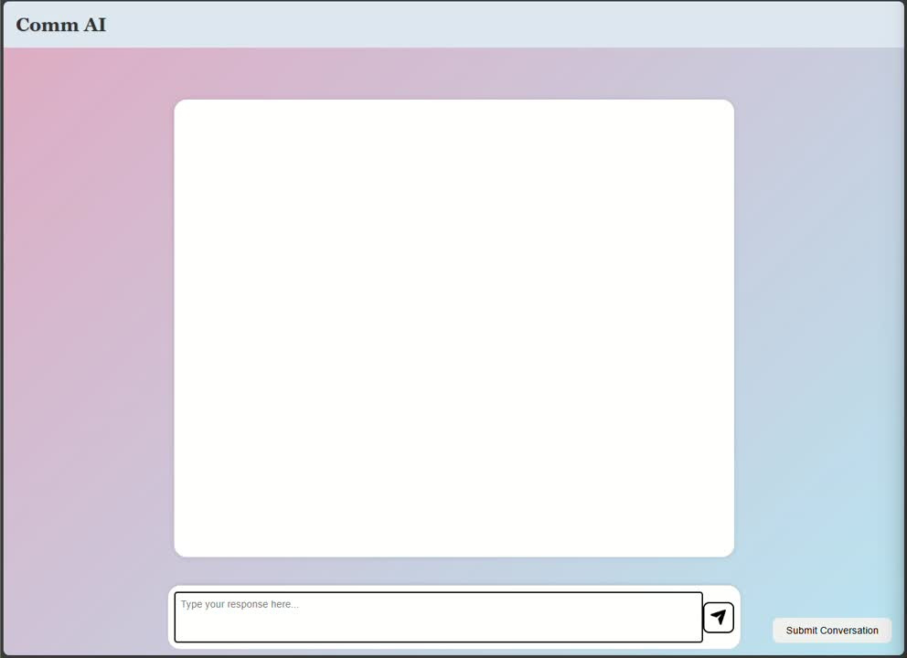
Intelligent Innovators
Home
Service
About Us
Contact
DEMO...

Slide 8
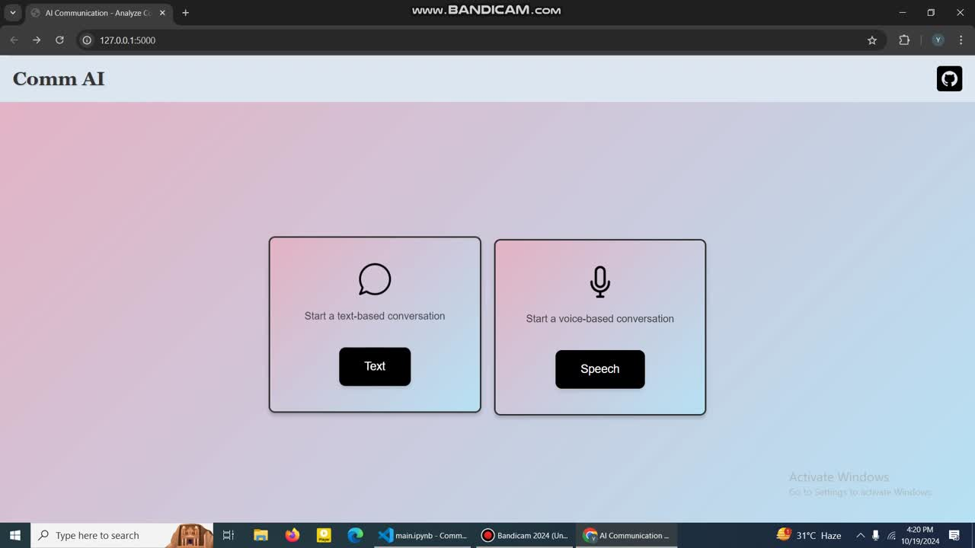
Intelligent Innovators
Home
Service
About Us
Contact
DEMO...

Slide 9

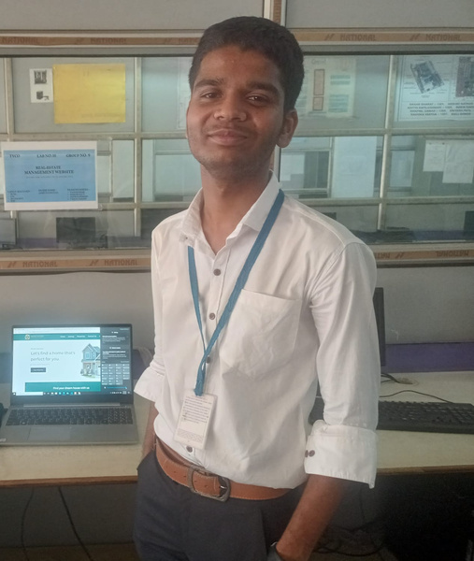

Intelligent Innovators
Home
Service
About Us
Contact
MEET OUR TEAM
Bari Ankit
(OnlyCR7)
Kerkar Yash
(YashKerkar0135)
Sapatale Komal (Komalsapatale)

Slide 10
Intelligent Innovators
Home
Service
About Us
Contact
THANK YOU
comm-ai.onrender.com

